Slide 1
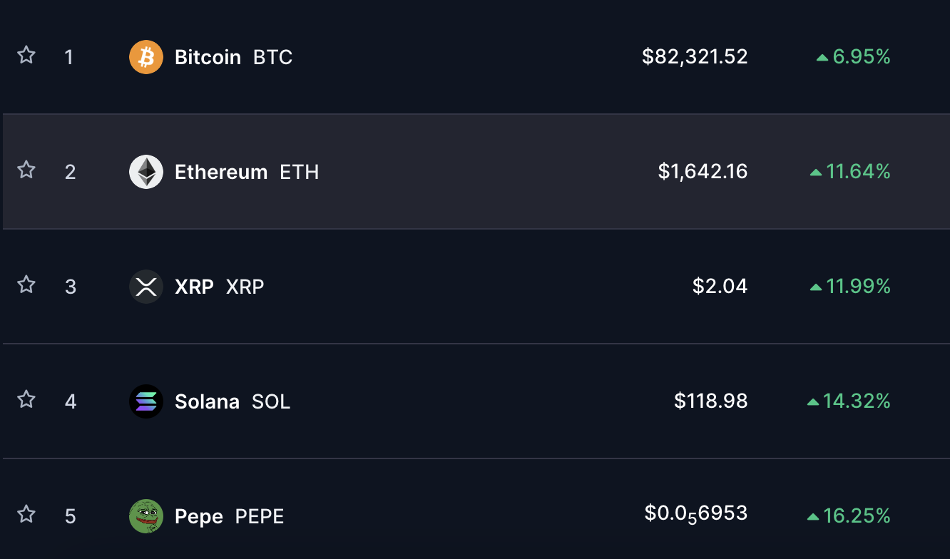

Cryptocurrency Price Forecasting
Using Hybrid Models

Slide 2


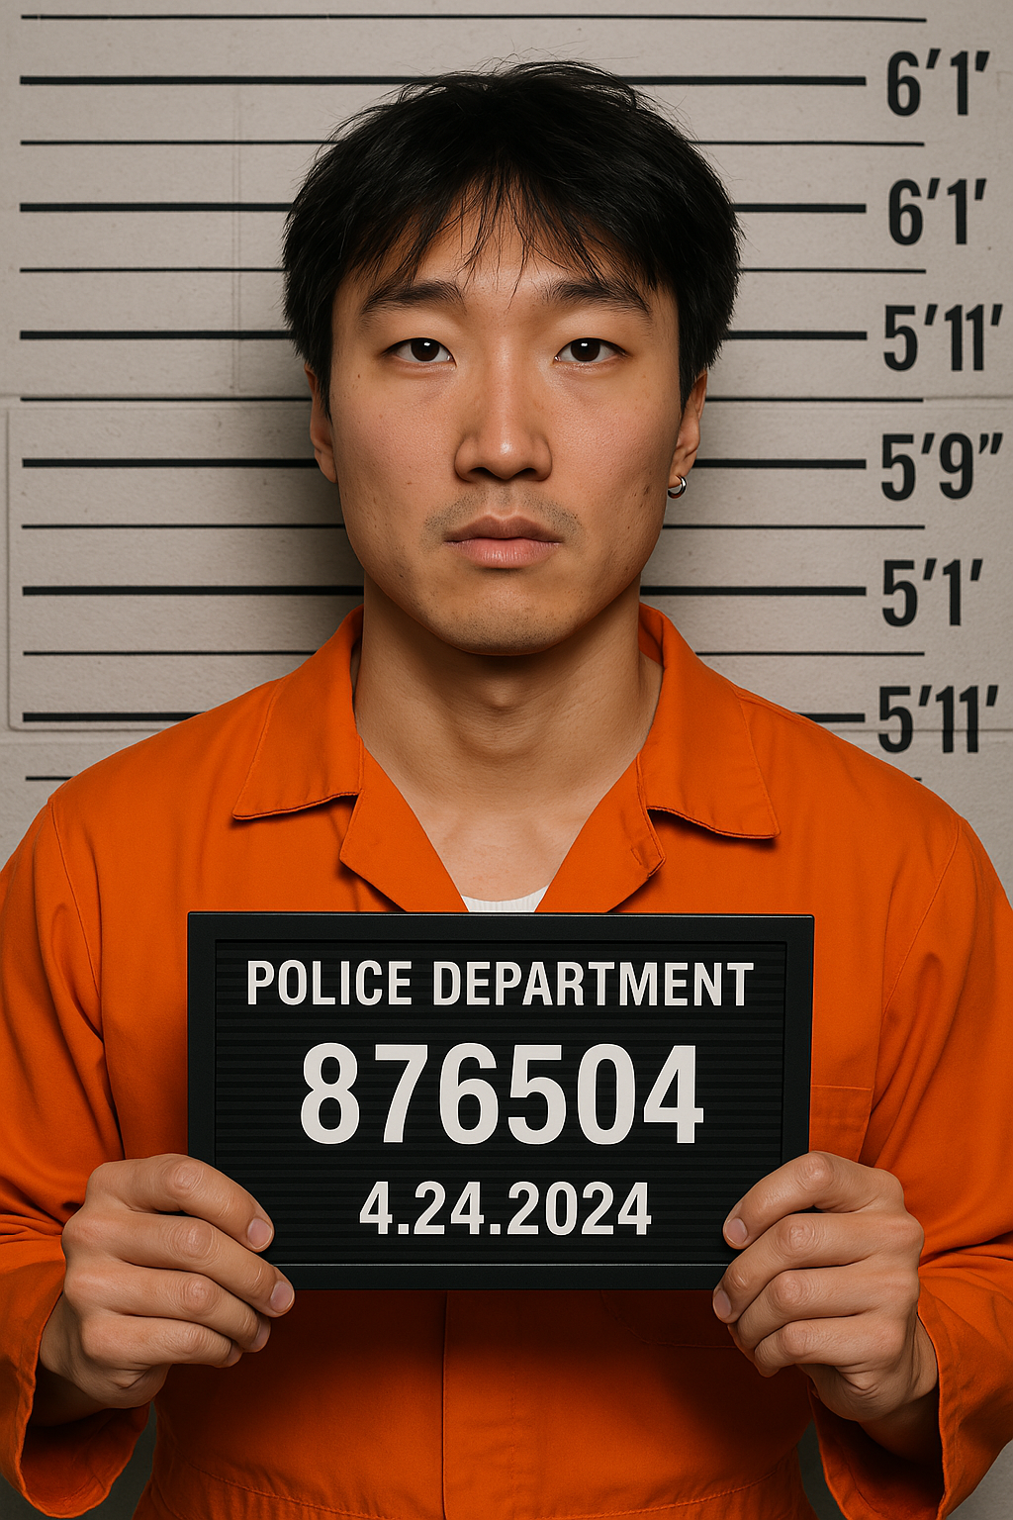

Our Team (Raghav.In.Budapest)
Raghav Raj Sah
Pranjal Chalise
Kaito Hikino
Aidan Walker(Volunteer Advisor)

Slide 3
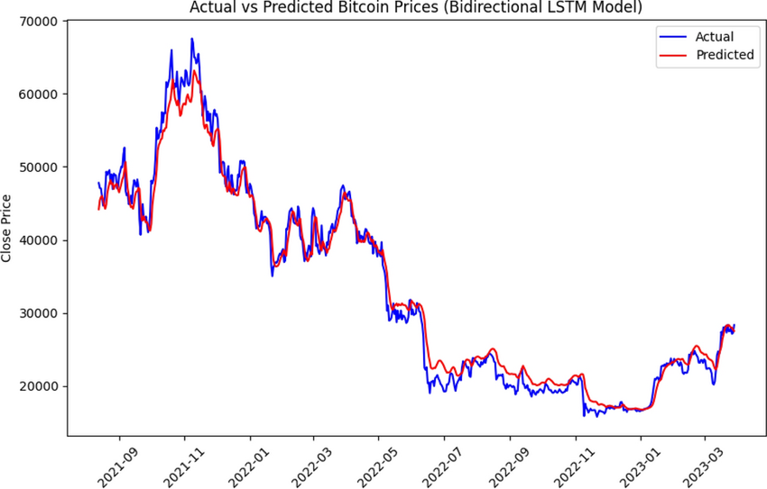
Our Project
This project focuses on developing a hybrid model for predicting cryptocurrency prices, such as Bitcoin and Ethereum. Our project combines deep learning techniques (e.g., LSTM) with traditional statistical models (e.g., ARIMA, XGBoost) to forecast prices effectively. To address the high volatility of cryptocurrencies we will consider external factors like social media sentiment which influences cryptocurrency price movements.

Slide 4
Milestone 1 Recap
In Milestone 1:
Data Preparation: Removed outliers, handled missing values, engineered features (moving averages, RSI, etc.).
Train/Test Split: 80% for training, 20% for testing.
Outcome: A ready-to-use dataset (Bitcoin-only) with relevant technical indicators.
Now:
we integrate two models (baseline + deep learning)
evaluate their performance

Slide 5
Baseline Model
Two Approaches:
Naive (Persistence) Model
ARIMA (Classic Statistical Model)
Naive Approach:
Our baseline predicts that tomorrow’s Bitcoin price = today’s price.”
Implementation Highlights:
Used the cleaned data from Milestone 1.
Created a new column (naive_pred) by shifting the ‘close’ column by 1 day.
Computed error metrics (MSE, RMSE, MAE) on the test set.

Slide 6
Deep Learning Model
Naive baseline sets a performance floor (RMSE ~614).
But it fails to account for momentum, volatility spikes, or external signals.
LSTM can (hopefully) learn those patterns to improve forecast accuracy
Selected an LSTM network because:
well-suited for time-series data, capturing sequential patterns better than traditional feedforward networks.

Slide 7
Deep Learning Model
LSTM Model Definition:
One LSTM layer with 64 units.
A Dropout layer to help prevent overfitting.
Training:
We run for 10 epochs with a batch size of 32, using mse as the loss function.
3. Evaluation:
Use the test sequences to get predictions from the model.
Calculate MSE, RMSE, and MAE.

Slide 8

Questions??
Baseline Model
DL Model (LSTM)
DL

